Slide 1



XML
Integrative Programming

Slide 2



Outline
Introduction
Why is XML?
XML vs HTML
XML vs JSON
XML structure
Syntax
Elements
Attributes
Namespace
www.its.ac.id
INSTITUT TEKNOLOGI SEPULUH NOPEMBER, Surabaya - Indonesia

Slide 3
Introduction
XML → eXtensible Markup Language
Similar with HTML that use markup language
XML design to store and transport data
Language independent
Self descriptive
Designed to be human readable and machine readable
Store the data in plain text format
www.its.ac.id
INSTITUT TEKNOLOGI SEPULUH NOPEMBER, Surabaya - Indonesia

Slide 4
Introduction
Example
<classOpen>
<class category=“dti”>
<name>Integrative Programming</name>
<day>Tuesday</day>
<date>22-02-2022</date>
<time>07:00</time>
</class>
</classOpen>
www.its.ac.id
INSTITUT TEKNOLOGI SEPULUH NOPEMBER, Surabaya - Indonesia

Slide 5
Why is XML?
A lot of IT system use XML
Often used for distributing data over the internet
XML can simplify platform changes
It can be used to separate data from presentation
www.its.ac.id
INSTITUT TEKNOLOGI SEPULUH NOPEMBER, Surabaya - Indonesia

Slide 6
XML vs HTML
XML
HTML
Design to carry data
The tags are NOT predefined
Case sensitive
Tags are extensible
Tags are used for describing the data
Design to display data
Predefined tags
NOT case sensitive
Limited number of tags
Tags are used to display the data
www.its.ac.id
INSTITUT TEKNOLOGI SEPULUH NOPEMBER, Surabaya - Indonesia

Slide 7
XML vs JSON
XML
JSON
It has start and end tags
More secure than JSON
Supports comments
It does not support array
More difficult to read and interpret compare to JSON
Supports various encoding
It does not use tag
Less secure
It does not support comments
It supports array
Easy to read
Supports only UTF-8 encoding
www.its.ac.id
INSTITUT TEKNOLOGI SEPULUH NOPEMBER, Surabaya - Indonesia

Slide 8
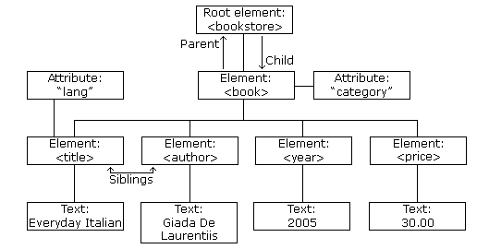
Structure
www.its.ac.id
INSTITUT TEKNOLOGI SEPULUH NOPEMBER, Surabaya - Indonesia

Slide 9
Syntax
XML starts with prolog: defining the XML versions and the character encoding
<?xml version=“1.0” encoding=“UTF-8”?>
The next line is root element, a document must have one root element as a parent of all other documents
<classOpen>
The child element
<class>
Attribute, the attribute value must be quoted
<class category=“dti”>
Element
The class has four child elements: name, day, date, time
www.its.ac.id
INSTITUT TEKNOLOGI SEPULUH NOPEMBER, Surabaya - Indonesia

Slide 10
Syntax
All elements must have a closing tag
XML pre-defined entity references
Comments in XML similar with HTML
<!-- write your comments here -->
&lt; | < | less than
&gt; | > | greater than
&amp; | & | ampersand
&apos; | ' | apostrophe
&quot; | " | quotation mark
www.its.ac.id
INSTITUT TEKNOLOGI SEPULUH NOPEMBER, Surabaya - Indonesia

Slide 11
Elements
Elements is start with start tag until end tag
<name>John doe</name>
An element can contain:
Text
Attributes
Other element
Or mix of the above
XML empty elements: an element without content
<element></element> or <element />
www.its.ac.id
INSTITUT TEKNOLOGI SEPULUH NOPEMBER, Surabaya - Indonesia

Slide 12
Elements
XML naming rules
Case-sensitive
Start with a letter or underscore
Can contain letters, digits, hyphens, underscores, and periods
Can not contain spaces
Best naming practices
Create descriptive name
Create short and simple name
Avoid “-” (course-name) → some software may think we want to subtract “course” with “name”
Avoid “.” (course.name) → some software may think “name” is the property of object “course”
Avoid “:” → reserved for namespace
Consistent
www.its.ac.id
INSTITUT TEKNOLOGI SEPULUH NOPEMBER, Surabaya - Indonesia

Slide 13
XML elements are extensible
XML elements can be extended to carry more information without make the application crash
Example:
<class category=“dti”>
<name>Integrative Programming</name>
<day>Tuesday</day>
<date>22-02-2022</date>
<time>07:00</time>
</class>
If the authors want to add additional information in that XML (such as lecturer) the system still can able to extract the information (name, day, date, time)
www.its.ac.id
INSTITUT TEKNOLOGI SEPULUH NOPEMBER, Surabaya - Indonesia

Slide 14
Attributes
The attribute in XML similar to HTML
The value of attribute must be quoted
Example:
<person gender=“male”>
Or
<person gender=‘male’>
The attribute is defined by the author of XML
www.its.ac.id
INSTITUT TEKNOLOGI SEPULUH NOPEMBER, Surabaya - Indonesia

Slide 15
Attributes
<class department=“dti”>
<name>Integrative Programming</name>
<day>Tuesday</day>
<date>22-02-2022</date>
<time>07:00</time>
</class>
===============================================================
<class>
<department>DTI</department>
<name>Integrative Programming</name>
<day>Tuesday</day>
<date>22-02-2022</date>
<time>07:00</time>
</class>
www.its.ac.id
INSTITUT TEKNOLOGI SEPULUH NOPEMBER, Surabaya - Indonesia

Slide 16
Attributes
When using attributes there are several things to be considered
Attributes cannot contain multiple values
Attributes cannot contain tree structures
Attribute are not easily expandable
The attribute is used as metadata
For example attribute “id” usually used as identifier of the elements
www.its.ac.id
INSTITUT TEKNOLOGI SEPULUH NOPEMBER, Surabaya - Indonesia

Slide 17
Namespace
XML namespace used to prevent element name conflict
Example
<table> <tr> <td>Apples</td> <td>Bananas</td> </tr> </table>
=====================================
<table> <name>African Coffee Table</name> <width>80</width> <length>120</length> </table>
XML that carried out HTML table information
It has element <table>
XML carries information about a table
It has element <table> but different meaning with the first example
www.its.ac.id
INSTITUT TEKNOLOGI SEPULUH NOPEMBER, Surabaya - Indonesia

Slide 18
Namespace
The naming conflict can be solved by using a prefix
<h:table> <h:tr> <h:td>Apples</h:td> <h:td>Bananas</h:td> </h:tr> </h:table>
=====================================
<a:table> <a:name>African Coffee Table</a:name> <a:width>80</a:width> <a:length>120</a:length> </a:table>
www.its.ac.id
INSTITUT TEKNOLOGI SEPULUH NOPEMBER, Surabaya - Indonesia

Slide 19
Namespace
The namespace in XML can be defined by an xmlns attribute
Syntax:
xmlnx:prefix=“URI”
<h:table xmlns:h="http://www.w3.org/TR/html4/"> <h:tr> <h:td>Apples</h:td> <h:td>Bananas</h:td> </h:tr> </h:table>
www.its.ac.id
INSTITUT TEKNOLOGI SEPULUH NOPEMBER, Surabaya - Indonesia

Slide 20
Namespace
Namespace can also be declared in the XML root element
<root xmlns:h="http://www.w3.org/TR/html4/" xmlns:f="https://www.w3schools.com/furniture"> <h:table> <h:tr> <h:td>Apples</h:td> <h:td>Bananas</h:td> </h:tr> </h:table> <f:table> <f:name>African Coffee Table</f:name> <f:width>80</f:width> <f:length>120</f:length> </f:table> </root>
www.its.ac.id
INSTITUT TEKNOLOGI SEPULUH NOPEMBER, Surabaya - Indonesia

Slide 21
Namespace
URI → Uniform Resource Identifier
Namespace URI is not use to look up information
URI is used to make the namespace unique
Usually URI in namespace is filled with a web page containing namespace information
www.its.ac.id
INSTITUT TEKNOLOGI SEPULUH NOPEMBER, Surabaya - Indonesia

Slide 22
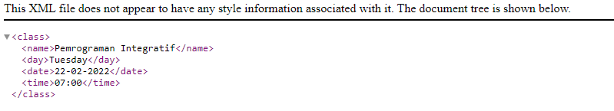
Display XML
XML can be display in all major browser
create XML and open in your web browser
www.its.ac.id
INSTITUT TEKNOLOGI SEPULUH NOPEMBER, Surabaya - Indonesia

Slide 23
XML validator
A valid XML must be well formed
Documents must have root element
The element must have a closing tag
Tags are case-sensitive
Elements must be properly nested
Attribute values must be quoted
A valid XML must conform to a document type definition
DTD – The original Document Type Definition
XML Schema – an XML-based alternative to DTD
www.its.ac.id
INSTITUT TEKNOLOGI SEPULUH NOPEMBER, Surabaya - Indonesia

Slide 24
DTD
DTD – Document Type Definition
DTD defines the structure and the legal elements and attributes of an XML document
Information about DTD document shown in DOCTYPE declaration
<?xml version=“1.0” encoding=“UTF-8”?>
<!DOCTYPE class SYSTEM “Class.dtd”>
<class category=“dti”>
<name>Integrative Programming</name>
<day>Tuesday</day>
<date>22-02-2022</date>
<time>07:00</time>
</class>
www.its.ac.id
INSTITUT TEKNOLOGI SEPULUH NOPEMBER, Surabaya - Indonesia

Slide 25
DTD
<?xml version=“1.0” encoding=“UTF-8”?>
<!DOCTYPE class SYSTEM “class.dtd”>
<class category=“dti”>
<name>Integrative Programming</name>
<day>Tuesday</day>
<date>22-02-2022</date>
<time>07:00</time>
</class>
Class.dtd
<!DOCTYPE class
[
<!ELEMENT class (name,day,date,time)
<!ELEMENT name (#PCDATA)>
<!ELEMENT day (#PCDATA)>
<!ELEMENT date (#PCDATA)>
<!ELEMENT time (#PCDATA)>
]>
#PCDATA – Parseable character data
www.its.ac.id
INSTITUT TEKNOLOGI SEPULUH NOPEMBER, Surabaya - Indonesia

Slide 26
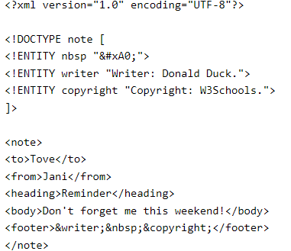
DTD
DTD can also be used to defines special character or string
www.its.ac.id
INSTITUT TEKNOLOGI SEPULUH NOPEMBER, Surabaya - Indonesia
Notes:
https://www.w3schools.com/xml/xml_dtd.asp

Slide 27
DTD
With DTD independent groups can agree to used a standard DTD for interchanging data
We can verify validity of the data
When we work in small XML just for our self, create DTD might be waste of time
If we create an application, wait until the application stable before create the DTD
www.its.ac.id
INSTITUT TEKNOLOGI SEPULUH NOPEMBER, Surabaya - Indonesia
Notes:
https://www.w3schools.com/xml/xml_dtd.asp

Slide 28
XML schema
An XML schema describe the structure of an XML, alternative to DTD
<xs:element name=“class"> <xs:complexType> <xs:sequence> <xs:element name=“name" type="xs:string"/> <xs:element name=“day" type="xs:string"/> <xs:element name=“date" type="xs:string"/> <xs:element name=“time" type="xs:string"/> </xs:sequence> </xs:complexType> </xs:element>
www.its.ac.id
INSTITUT TEKNOLOGI SEPULUH NOPEMBER, Surabaya - Indonesia

Slide 29
XML schema
XML schema more powerful than DTD
Support data type
It is easier to describe document content
It is easier to define restriction on data
It is easier to validate the correctness of data
It is easier to convert data between different types
Use XML syntax
www.its.ac.id
INSTITUT TEKNOLOGI SEPULUH NOPEMBER, Surabaya - Indonesia

Slide 30
Exercise
www.its.ac.id
INSTITUT TEKNOLOGI SEPULUH NOPEMBER, Surabaya - Indonesia

Slide 31
TERIMA KASIH

